Slide 2
Introduction to ADLS Gen2
Jan Remko Yntema
Data Architect
Ilionx
jryntema@ilionx.com

Slide 3
Agenda
Azure Storage
Azure Data Lake Storage Gen2
SQL

Slide 4
Azure Storage

Slide 5
Azure Storage
The Azure storage foundation
Consists of
Azure Blobs
Azure Files
Azure Queue
Azure Tables
Azure Managed Disk

Slide 6
Azure Storage Account
Defines available features and pricing model
Blob storage account (why not use V2?)
General-purpose V1 account (old)
General-purpose V2 account

Slide 7
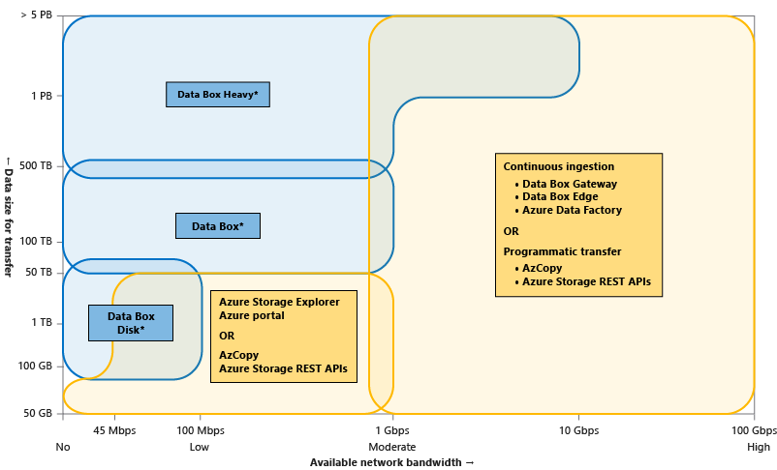
Azure Storage Data Movement

Slide 8
Azure Data Lake Storage Gen2

Slide 9
What makes a great Data Lake?
Massive Scale
Granular, multi-layered security
Optimized for maximum performance
Integration friendly
Rich data management and governance
Cost effective

Slide 10
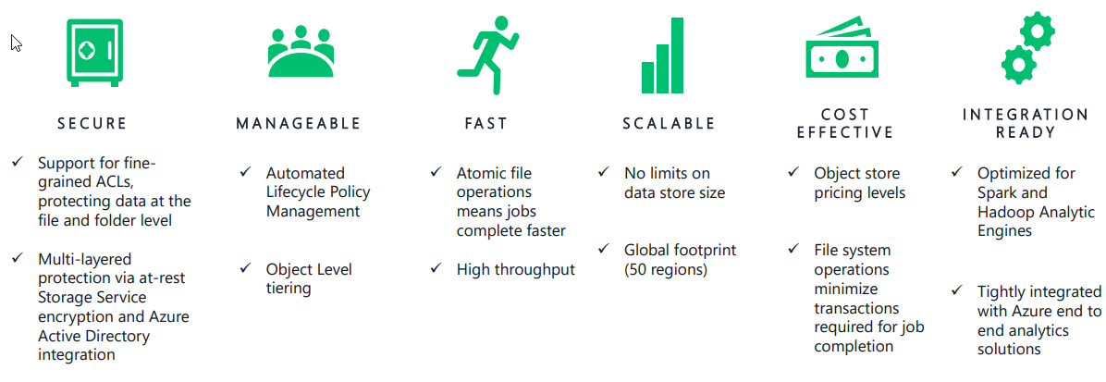
Azure Data Lake Storage Gen2

Slide 11
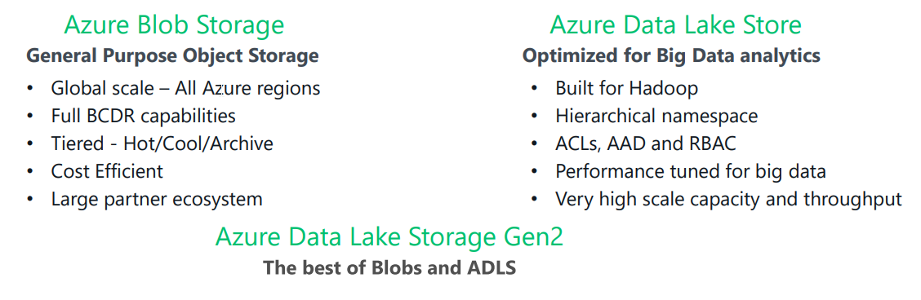
Convergence of two Storage Services

Slide 12
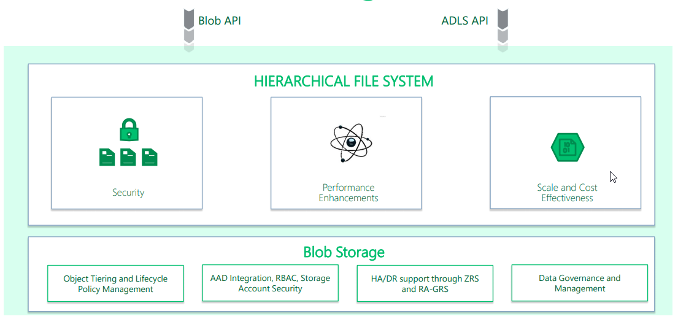
Azure Data Lake Storage Gen2 Architecture

Slide 13
Benefits of Hierarchical File System
Query Performance
Meta data operations
Data consistency via Atomic Operations
Granular Security at the directory level

Slide 14
Unsupported features
Azure Data Lake Analytics (U-SQL)
Either blob or hierarchical
Azure Data Catalog

Slide 15
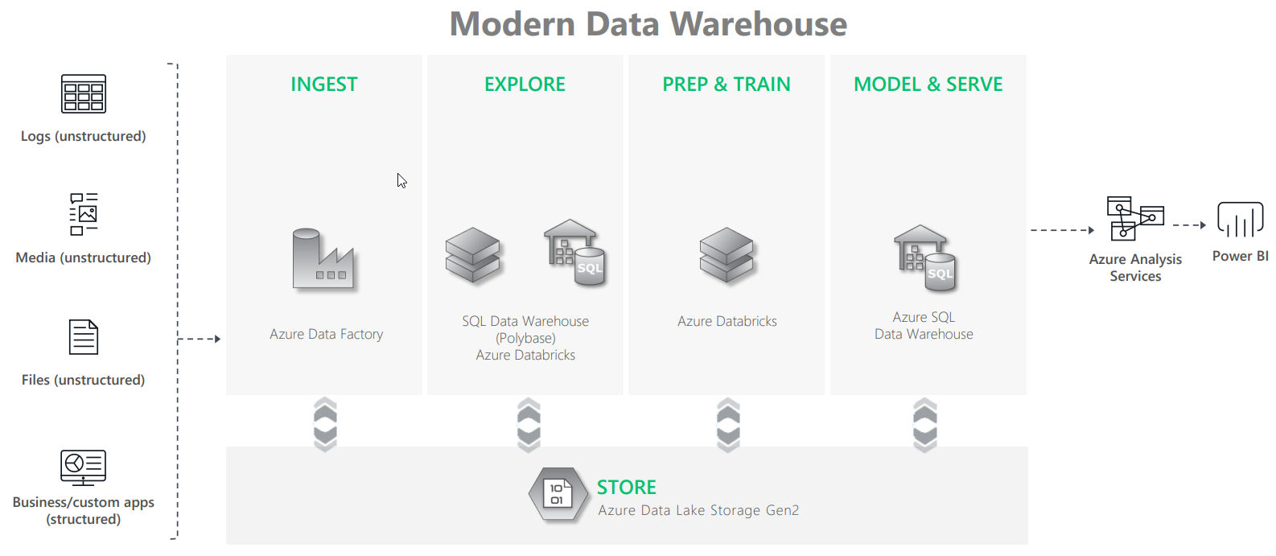
End to End Analytics

Slide 16
Data Security in ADLS Gen2
All data (including metadata) is automatically encrypted using Storage Service Encryption (SSE)
Azure Active Directory (Azure AD) and Role-Based Access Control (RBAC) are supported
Data can be secured in transit between an application and Azure by using Client-Side Encryption, HTTPS, or SMB 3.0
Delegated access to the data objects in Azure Storage can be granted using Shared Access Signatures.

